Slide 1



COMP
1521
WEEK 5 TUTE

Slide 2

CONTENTS
01
HEX, OCTAL, BINARY
02
BITWISE OPERATION
03
INTEGERS
04
BCD 🤢

Slide 3
Different Binary Representations
Binary
Octal
Hexadecimal
Decimal
10100111
247
A7
167

Slide 4
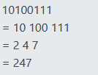
Different Binary Representations
decimal (base 10), hexadecimal (base 16), octal (base 8) or binary (base 2)
Binary
Octal
Hexadecimal
Decimal
1 bit = 1 digit
3bits = 1 digit
4 bits = 1 digit
10100111
247
A7
167
10100111
= 1010 0111
= A 7
split into groups of 4
split into groups of 3

Slide 5


Different Binary Representations
Binary
Octal
Hexadecimal
Decimal
1 bit = 1 digit
3bits = 1 digit
4 bits = 1 digit
167
10100111
247
A7
from octal:
10100111
= 1010 0111
= A 7
from hex:

Slide 6
Different Binary Representations
Binary
Octal
Hexadecimal
Decimal
1 bit = 1 digit
3bits = 1 digit
4 bits = 1 digit
167
10100111
247
A7
10100111
= 1010 0111
= A 7
from octal:
from hex:
IN C:
0b10100111
0247
0xA7
167

Slide 7
Converting Decimal to Binary
100
1: decompose it into powers of two
2: the powers are just the position of ‘1’s in bits!

Slide 8
Converting Decimal to Binary
1.
100 = 64 + 32 + 4
1: decompose it into powers of two
2: the powers are just the position of ‘1’s in bits!

Slide 9
Converting Decimal to Binary
1.
100 = 64 + 32 + 4
= 2^6 + 2^5 + 2^2
1: decompose it into powers of two
2: the powers are just the position of ‘1’s in bits!

Slide 10
Converting Decimal to Binary
1.
100 = 64 + 32 + 4
= 2^6 + 2^5 + 2^2
2.
= 0110 0100
1: decompose it into powers of two
2: the powers are just the position of ‘1’s in bits!

Slide 11
Converting Decimal to Binary
1.
100 = 64 + 32 + 4
= 2^6 + 2^5 + 2^2
2.
= 0110 0100
7654 3210
1: decompose it into powers of two
2: the powers are just the position of ‘1’s in bits!

Slide 12
Conversion graph
Binary
Hex
Octal
Dec
Stay on the path :）

Slide 13
Some hex good to knows.
every digit is 4 bits.
0xA023FD is a 24 bit number.
F -> loaded one’s (1111)
7 -> loaded one’s except the first (0111)
digits are independent of each other in binary.
0xF7 is 1111 0111
F 7
13(dec) in binary is 1101. -> not independent!! (decimal bad)

Slide 14
q2 a) d) h) g)

Slide 15
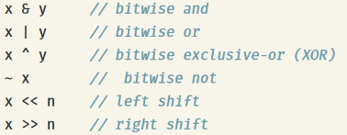
Bitwise operations

Slide 16
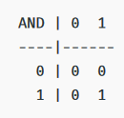
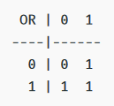

Bitwise operations

Slide 17
Bitwise operations
“if both are 1, enter 1”
“if either are 1, enter 1”
left shift by 1 bit multiplies your number by 2
left shift by n bits multiplies your number by 2^n

Slide 18
Why bitwise?
C does not have functions to interpret bit -
you cannot access the third bit of 10100110 by doing number[2]. It is not an array
Instead you must extract it using bitwise operations

Slide 19
Why bitwise?
C does not have functions to interpret bit -
you cannot access the third bit of 10100110 by doing number[2]. It is not an array
Instead you must extract it using bitwise operations
10100 1 10
& 00100000
00100000
(because 1 & 1 = 1 but 1 & 0 = 0)

Slide 20
Why bitwise?
C does not have functions to interpret bit -
you cannot access the third bit of 10100110 by doing number[2]. It is not an array
Instead you must extract it using bitwise operations
10100 1 10
& 00100000
00100000
(because 1 & 1 = 1 but 1 & 0 = 0)
result = 00100000 >> 5
result = 0000 0001.

Slide 21
When to use each operator
read/copy or remove bits in a number (010 -> 000)
add 1 bits to a number (000 -> 010)
Flipping bits (010 -> 101)
Flipping logic (0 -> 1) or removing 1 bits (010 -> 000)
positioning your mask
positioning your mask

Slide 22
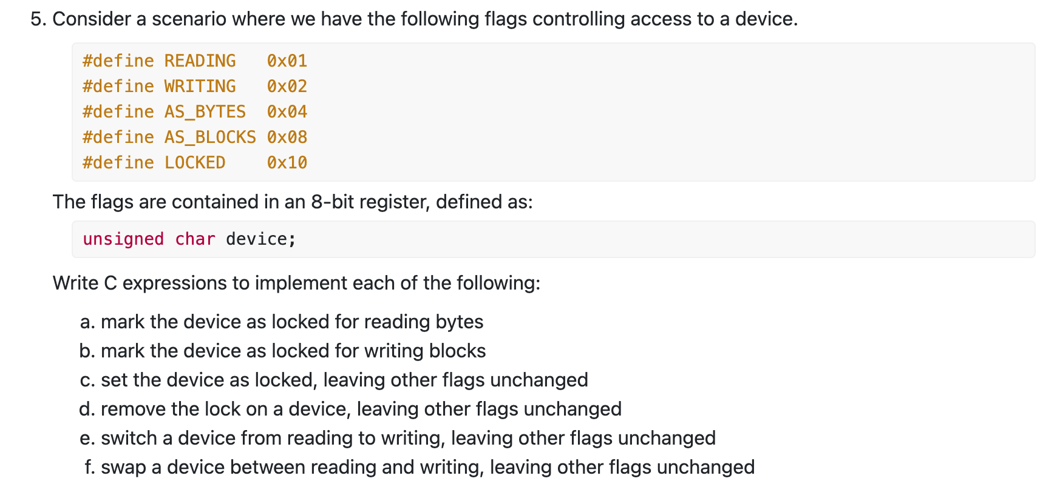
q5
a, d, f

Slide 23
a) This guarantees that LOCKED is set to 1 while leaving other bits unchanged.

Slide 24
0 | 1 = 1 (Forces the bit to 1 if it was 0)
1 | 0 = 1 (Keeps the bit 1 if it was already 1)
a) This guarantees that LOCKED is set to 1 while leaving other bits unchanged.
device = (READING | AS_BYTES | LOCKED);

Slide 25
d) Clearing the LOCKED Flag - This ensures that LOCKED is now 0 while other bits remain unchanged.

Slide 26
1 & 1 = 1 (Keeps the bit 1 if it was already 1)
1 & 0 = 0 (Forces the bit to 0 if it was 1)
d) Clearing the LOCKED Flag - This ensures that LOCKED is now 0 while other bits remain unchanged.
device = device & ~LOCKED

Slide 27
F) This means if READING was set, it is now cleared and WRITING is set, effectively swapping modes

Slide 28
When we want to switch (toggle) a bit between 0 and 1, we use bitwise XOR (^).
1 ^ 1 = 0 (Flips 1 to 0)
0 ^ 1 = 1 (Flips 0 to 1)
F) This means if READING was set, it is now cleared and WRITING is set, effectively swapping modes
device = device ^ (READING | WRITING);

Slide 29
Masks
Mask is an arbitrary binary value we use to help us in bitwise operations.

Slide 30

Common masks:
When to use?
When trying to address specific bits!
shifting a bit mask of “1” to get to a certain bit
e.g. tell me if the following is negative or positive:
0b1011 0100

Slide 31

Common masks:
When to use?
using “F” to get “loaded 1’s“
When trying to address specific bytes!
e.g. convert endian-ness (flip biggest bytes to smallest bytes)
01110010 10000000 -> 10000000 01110010

Slide 32
q3 a) to e)

Slide 33
Integers
uint64_t
u = unsigned
64 = 64 bits (8 bytes) long
int16_t
16 = 16 bits (2 bytes) long
signed

Slide 34
q1

Slide 35
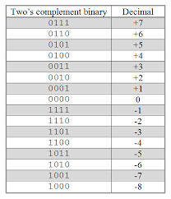

Negative Integers
e.g. for a 4 bit number,
9 is of course 0b1001

Slide 36
The leftmost bit in a binary number is called the Sign Bit.
0 represents a positive number.
1 represents a negative number.
How to Convert a Negative Number to Two’s Complement
Start with the positive binary representation.
Invert all bits (flip 0s to 1s and 1s to 0s).
Add 1 to the result.
Example: Convert -7 in 4-bit representation
7 in binary (4-bit): 0111
Invert bits: 1000
Add 1: 1001
Final result: 1001 (which represents -7 in two’s complement).

Slide 37
Negative Integer padding (optional for week 5)
Consider the scenario: you have a 4 bit negative integer (-7) but you want to make it 8 bits long. How can you convert it?
Consider the positive integer case first:
0111 -> 0000 0111
What about for -7?

Slide 38
Negative Integer padding
Consider the scenario: you have a 4 bit negative integer (-7) but you want to make it 8 bits long. How can you convert it?
Consider the positive integer case first:
0111 -> 0000 0111
What about for -7?
To convert it, we use “padding”. For positive numbers we pad with “0s”
but for negative numbers we pad with 1's
-7 = 1111 1001 = 2^8 - 7

Slide 39
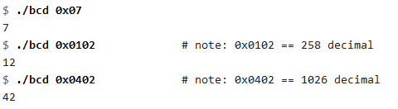
BCD - binary coded decimal
BCD is where each byte is interpreted as 1 digit in decimal.

Slide 40
BCD - binary coded decimal
BCD is where each byte is interpreted as 1 digit in decimal.
In the 0x0402 case, we separate it into its bytes.
0x 04 02
4 2
and thus we have 42!

Slide 41
BCD - binary coded decimal
BCD is where each byte is interpreted as 1 digit in decimal.
In the 0x0402 case, we separate it into its bytes.
0x 04 02
4 2
and thus we have 42!
Note that all BCDs must be between 0 and 9 inclusive - as that is the limit of a decimal!. 0x0A02 would not be a valid BCD as A(10) cannot be represented as a decimal digit.

Slide 42
q4, q8

Slide 43
uint32_t six_middle_bits(uint32_t u) { return (u >> 13) & 0x3F;}

